Slide 1
Deep Learning
Week 6

Slide 2
Neural Networks

Slide 3
Topics covered so far
Neural Networks
General Intro
Reminder of nonlinear features
Single unit and activation functions
Multiple layers
Architecture
Cross Entropy Loss
Gradient descent
Basic Training Algorithms, SGD, Minibatch

Slide 4
Discussion questions
What is a neural network and what do different layers in an NN represent?
What is an activation function and what are the different types of activation functions?
What do forward and back propagation mean in neural networks?
What is the gradient descent algorithm and how does it work?
How do we reduce overfitting in neural networks?

Slide 5
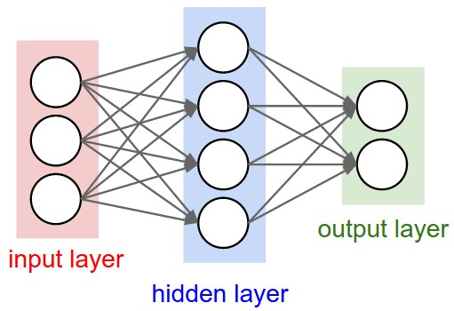
Neural Networks
Artificial Neural Networks (ANNs) are inspired by biological neural networks and employ a collection of interconnected artificial neurons to extract the patterns from given data.
It consists of three types of layers:
Input layer
Represents dimensions of the input vector (one node for each dimension)
Hidden layer(s)
Represents the intermediary nodes that divide the input space into regions with (soft) boundaries
Given enough hidden nodes, we can model an arbitrary input-output relation
It takes in a set of weighted input and produces output through an activation function
Output layer
Represents the output of the neural network
Mostly, it doesn't have an activation function
Image Source

Slide 6
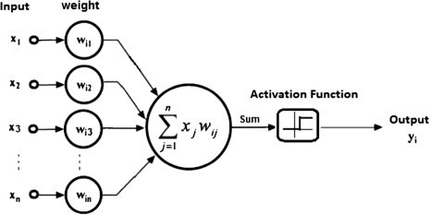
Activation functions
An artificial neural network works in three steps
First, it multiplies the input signals with corresponding weights
Second, it adds the weighted signals together
Third, it converts the result into another value using a mathematical transformation (activation function)
For the third step, there are multiple mathematical functions available that can be used for the activation function.
The purpose of the activation function is to act like a switch for the neuron.
The activation function is critical to the overall functioning of the neural network. Without it, the whole neural network will mathematically become equivalent to one single neuron!
The activation function is one of the critical components that give neural networks the ability to deal with complex problems, by tackling the nonlinearity of the patterns in the data.
Source: Quora

Slide 7
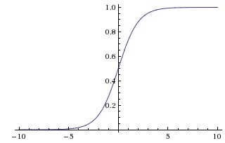
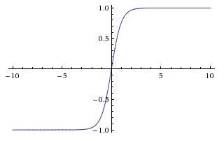
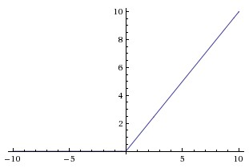
Types of activation functions
These are some activation functions that are generally used in neural networks:
The Sigmoid function
The Tanh function
The ReLU (Rectified Linear Unit) function
Sigmoid
Tanh
ReLU
Range : 0 to 1
Gives probabilities
Range : -1 to 1
More steeper than sigmoid
Range : 0 to ∞
Less computationally expensive
Image Source

Slide 8
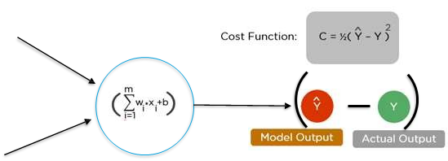
Forward Propagation
In the forward propagation, the input data is propagated forward from the input layer through the hidden layer until it reaches the final/output layer where predictions are made.
At every layer, data gets transformed in three steps in every neuron
Sum weighted input at every neuron by multiplying 𝑋 by the hidden weight 𝑊ℎ and the bias
Apply the activation function on the sum
Pass the result to all the neurons in the next layer
The last layer is the output layer, which may have a sigmoid function (for binary classification) or a softmax function (if the network is a multi-class classifier). The output layer gives the predictions of the neural network.
After getting the predictions, we use an optimization algorithm that helps us to minimize error (cost) function E(x) which is simply a mathematical function dependent on the model’s learnable parameters which are used in computing the target values (Y) from the set of predictors (X) used in the model.

Slide 9
Back Propagation
Back propagation is the process of learning that the neural network employs to re-calibrate the weights at every layer and every node to minimize the error in the output layer
During the first pass of forward propagation, the weights are random numbers
The output of the first iteration is not always accurate. The difference between actual value / class and predicted value / class is the error
All the nodes in all the preceding layers contribute to error and hence need to get their share of the error and correct their weights
This process of allocating a proportion of the error (error gradient) to all the nodes in the previous layer is called the back propagation
The goal of back propagation is to adjust weights in proportion to the error contribution and in iterative process identify the optimal combination of weights
At each layer, at each node, the gradient descent algorithm is applied to adjust the weights
Image Source

Slide 10
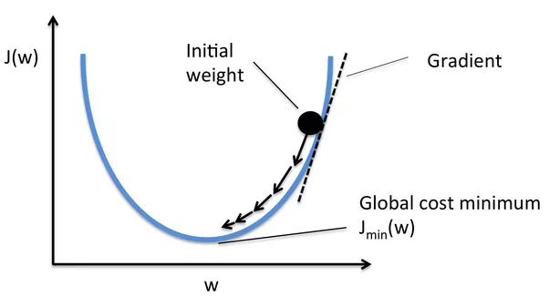
Gradient Descent Algorithm
The goal of optimization is to find a set of weights that minimizes the loss function
Optimization functions usually calculate the gradient i.e. the partial derivative of loss function with respect to weights, and the weights are modified in the opposite direction of the calculated gradient. This cycle is repeated until we reach the minima of loss function
The procedure of repeatedly evaluating the gradient and then performing a parameter update is called Gradient Descent
Learning Rate:
It is a hyperparameter which determines the step size (the amount by which the weights are updated)
We can try out different values of learning rate to improve the results
Image Source

Slide 11
Gradient Descent variations
 | Batch Gradient Descent | Stochastic Gradient descent | Mini Batch Gradient Descent
Working | It updates the parameter by calculating gradients of whole dataset | It updates the parameters by calculating gradients for each training example | It updates the parameters by calculating gradients for every mini batch of “n” training examples. It is a combination of batch and stochastic gradient descent
Advantages | It is computationally efficient and gives stable convergence | It is faster in learning than batch gradient descent and gives immediate performance insights | It is computationally efficient, fast to learn and gives stable convergence
Disadvantages | It learns very slowly and the chances of getting stuck in a local minima are high | It is computationally intensive and can give noisy gradients | It adds up one more hyperparameter to tune.

Slide 12
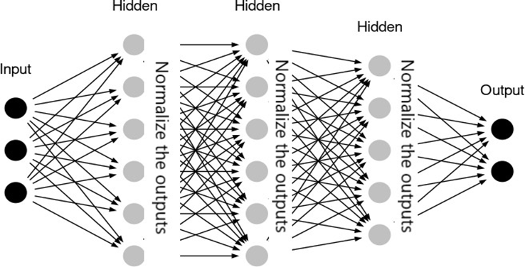
Overfitting in NN
Deep neural networks are prone to overfitting since they try to capture complex patterns in the data but they may also capture the noise.
We can use the Ridge and Lasso regression techniques (that we have covered in previous modules) to reduce overfitting. There are also some other ways to reduce overfitting in a Deep Neural Network:
Batch Normalization: Batch normalization is a technique for improving the performance and stability of neural networks. The idea is to normalize the inputs of each layer in such a way that they have a mean output activation of zero and standard deviation of one. This is analogous to how the inputs to networks are standardized.
This approach leads to faster learning rates since normalization ensures there’s no activation value that’s too high or too low, as well as allowing each layer to learn independently of the others.
Image Source

Slide 13
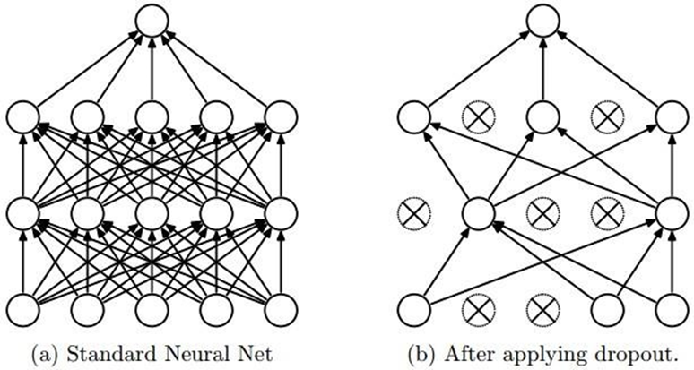
Overfitting in NN
Dropout: A fully connected layer occupies most of the parameters, and hence, neurons develop co-dependency amongst each other during training which curbs the individual power of each neuron leading to over-fitting of the training data.
In dropout, we randomly shut down some fraction of a layer’s neurons at each training step by zeroing out the neuron values.
The fraction of neurons to be zeroed out is known as the dropout rate, rd.
The remaining neurons have their values multiplied by 1/(1-rd) so that the overall sum of the neuron values remains the same.
Source: (Srivastava et al. Dropout: A Simple Way to Prevent Neural Networks from Overfitting. JMLR, 2014)

Slide 14
Case Study
Neural Networks

Slide 15
CNN

Slide 16
Discussion questions
What are convolutional neural networks and how are they different from ANNs?
How do filters/kernels work for feature detection in CNNs?
How do pooling, padding and stride operations work in CNNs?
What is transfer learning and how can we use this in CNNs?

Slide 17
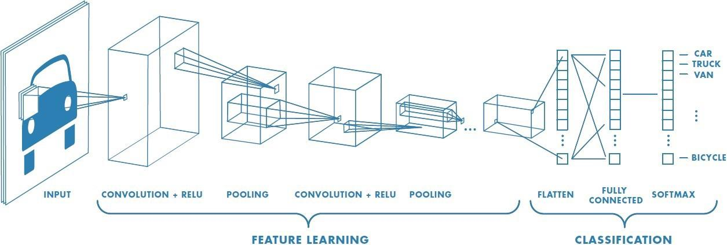
Convolutional Neural Networks
CNNs are a special type of neural network designed to work with image data. CNNs use convolutional layers - hidden layers which perform convolution operations. They have some different characteristics to ANNs:
Unlike ANNs, CNNs capture the spatial structure of the image
CNNs follow the concept of parameter sharing i.e. one filter is applied over the whole image, because of which they are much more computationally efficient.
The first part in this architecture is the convolutional layer followed by the pooling layer and the second part is the fully connected layer. This whole architecture is called a convolutional neural network.
Image Source

Slide 18
The convolutional layer - Filter/Kernel
A convolution operation uses a small array of numbers called a filter/kernel on the input image.
Each filter is designed to identify a specific feature in the input space of the image, such as horizontal edges, vertical edges etc.
A CNN is able to successfully capture the spatial and temporal dependencies in an image through the application of relevant filters.
The role of the CNN is to reduce the images into a form which is easier to process, without losing features which are important for getting a good prediction.
This image shows how the convolution operation works in a CNN
It uses a 3x3 filter on a 5x5 image
The resulted feature is a 3x3 image which is the convolved feature

Slide 19
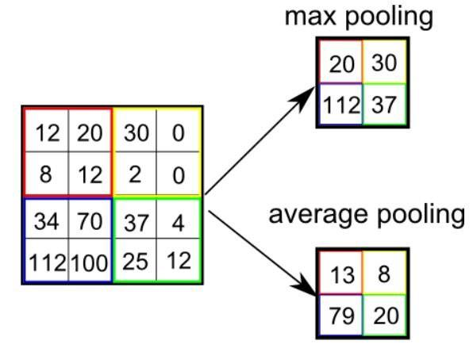
Pooling layer in CNNs
After a convolution operation, we usually perform pooling to reduce the dimensions of the feature map
It enables us to reduce the number of parameters, which both reduces the training time and the overfitting
Pooling layers downsample each feature map independently, reducing the height and width, but keeping the depth same.
There are two types of pooling - Max and Average
Max pooling just takes the maximum value whereas average pooling takes the average value in the pooling window
Contrary to the convolution operation, pooling has no parameters.
In these gifs, we can see how both max and average pooling work

Slide 20
Padding & Stride in CNNs
Stride specifies how much we move the filter at each step. By default the value of the stride is 1 and is represented by the first figure in the previous slide.
We can also increase the value of stride if we want less overlap between the filters. It also makes the resulting feature map smaller since we are skipping over some locations.
The second figure in the previous slide demonstrates the stride 2.
We see that after using stride, the size of the feature map is smaller than the input. If we want to maintain the same dimensions, we can use padding to surround the input with zeros.
The grey area around the input in the third figure is the padding.
We either pad with zeros or the values on the edge, to match the dimensions of the feature map with the input.
Padding is commonly used in CNNs to preserve the size of the feature maps, otherwise they would shrink at each layer, which is not desirable.

Slide 21
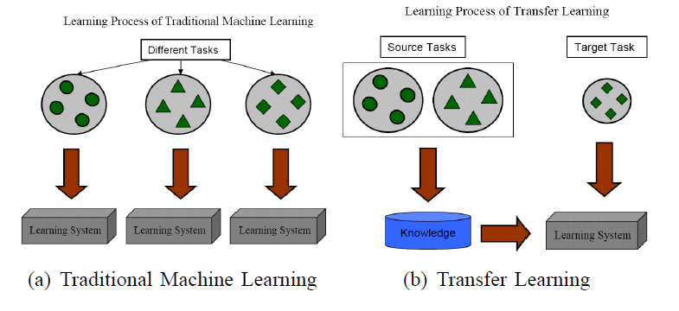
Transfer Learning
If you are using a specific NN architecture that has been trained before, you can use these pretrained parameters/weights instead of random initialization to solve your problem
It can help you boost the performance of the NN.
The pretrained models might have trained on large datasets like ImageNet, and taken a lot of time to learn those parameters/weights with optimized hyperparameters. This can save you a lot of time.
If you have enough data, you can fine tune all the layers in your pretrained network but don't random initialize the parameters, leave the learned parameters as they are and learn from there.

Slide 22
Case Study CNN

